Slide 1
Name- Chetan patil Topic- shell script

Slide 2
What is shell script?
It is nothing but a list of commands stored in a file. It reduces our effort to run the same task or commands again and again

Slide 3
Some of the examples of scripts

Slide 4
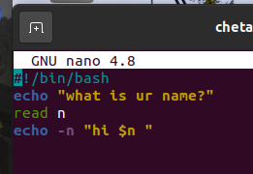

Printing Script

Slide 5
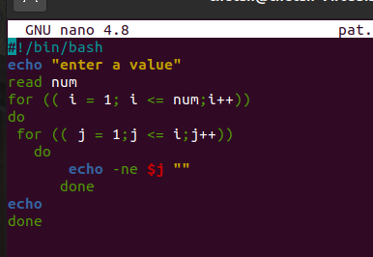
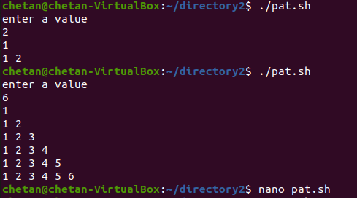
Pattern script

Slide 6
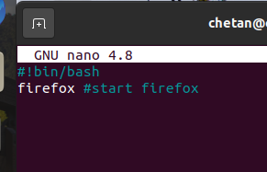
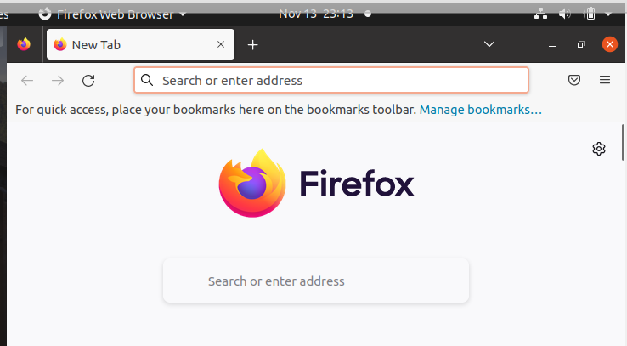
Starting browser script

Slide 7
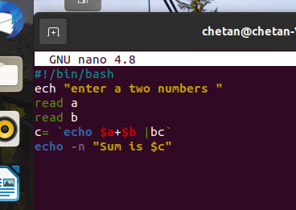
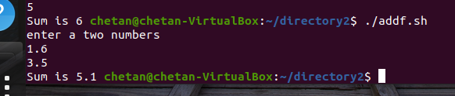
Addition of 2 floating number script

